Slide 1
Exception Handling

Slide 2
Exceptions in Java
An exception is an event, which occurs during the execution of a program, that disrupts the normal flow of the program's instructions.
An exception is an abnormal condition that arises in a code sequence at run time.
A Java exception is an object that describes an exceptional (that is, error) condition that has occurred in a piece of code.
In other words, “An exception is a run-time error.”

Slide 3
An Exception is a run-time error that can be handled programmatically in the application and does not result in abnormal program termination.
Exception handling is a mechanism that facilitates programmatic handling of run-time errors.
In java, each run-time error is represented by an object.

Slide 4
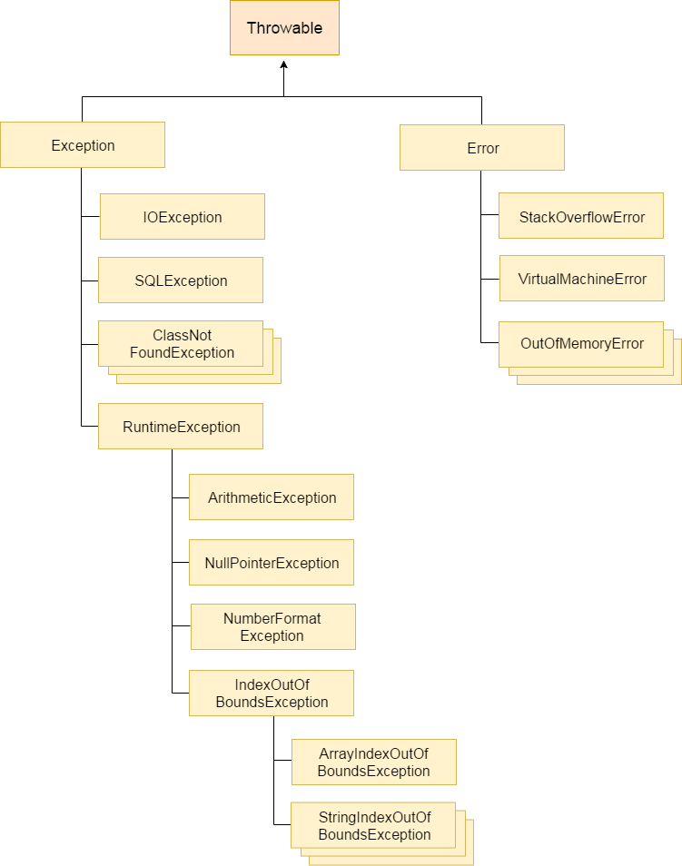
Hierarchy of exception classes

Slide 5
At the root of the class hierarchy, there is a class named ‘Throwable’ which represents the basic features of run-time errors.
There are two non-abstract sub-classes of Throwable.
Exception : can be handled
Error : can’t be handled
RuntimeException is the sub-class of Exception.
Each exception is a run-time error but all run-time errors are not exceptions.

Slide 6
Types of Exceptions: Checked and Unchecked
Checked Exception
These are the exceptions that are checked at compile time. If some code within a method throws a checked exception, then the method must either handle the exception or it must specify the exception using throws keyword.
Checked Exceptions are those, that have to be either caught or declared to be thrown in the method in which they are raised.
Examples: FileNotFoundException, IOException,
SQLException, ClassNotFoundException
Example in the next slide:
.

Slide 7
Checked Exception
import java.io.*;
public class checked {
public static void main(String[] args) {
FileReader file = new FileReader("C:\\Users\\abc\\a.txt");
BufferedReader fileInput = new BufferedReader(file);
for (int counter = 0; counter < 3; counter++)
System.out.println(fileInput.readLine());
fileInput.close();
}
}
The program doesn’t compile, because the function main() uses FileReader() and FileReader() throws a checked exception FileNotFoundException. It also uses readLine() and close() methods, and these methods also throw checked exception IOException

Slide 8
Method throwing Checked Exception
import java.io.*;
public class checkedcorrect {
public static void main(String[] args) throws IOException {
FileReader file = new FileReader("C:\\Users\\a.txt");
BufferedReader fileInput = new BufferedReader(file);
for (int counter = 0; counter < 3; counter++)
System.out.println(fileInput.readLine());
fileInput.close();
}
}
We have used throws in the below program. Since FileNotFoundException is a subclass of IOException, we can just specify IOException in the throws list and make the above program compiler-error-free.
Output:
<First three lines a.txt will be printed>

Slide 9
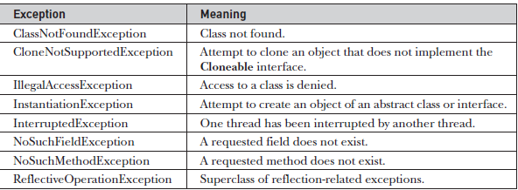
Java’s Checked Exceptions defined in java.lang package
IOException
SQLException
FileNotFoundException[Sub-class of IOException]

Slide 10
Unchecked Exceptions
Unchecked Exceptions are those that are not forced by the compiler either to be caught or to be thrown.
Unchecked exceptions are not checked at compile time. It means if your program is throwing an unchecked exception and even if you didn’t handle/declare that exception, the program won’t give a compilation error.
Most of the times these exception occurs due to the bad data provided by user during the user-program interaction. It is up to the programmer to judge the conditions in advance, that can cause such exceptions and handle them appropriately.
In Java exceptions/or classes under Error and RuntimeException classes are unchecked exceptions

Slide 11
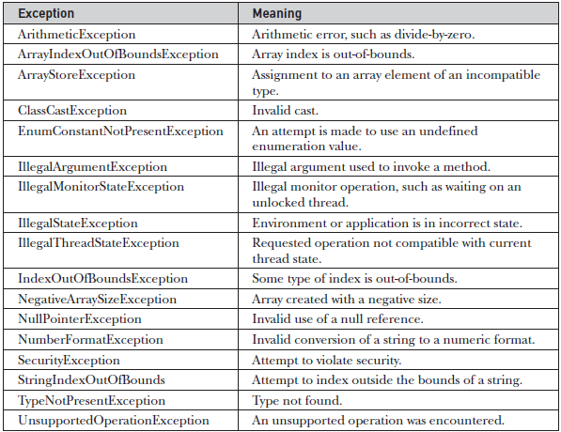
Unchecked Exceptions[Subclasses of RuntimeException class defined in java.lang package

Slide 12
How a default exception is thrown by JVM?? Consider the following Java program. It compiles fine, but it throws ArithmeticException when run. The compiler allows it to compile, because ArithmeticException is an unchecked exception.
public class Main {
public static void main(String args[]) {
int x = 0;
int y = 10;
int z = y/x;
}
}
Output:
Exception in thread "main" java.lang.ArithmeticException: / by zero at Main.main(Main.java:5) Java Result: 1

Slide 13
Key points from the previous example
In the previous example, we haven’t supplied any exception handlers of our own.
So the exception is caught by the default handler provided by the Java run-time system.
Any exception that is not caught by your program will ultimately be processed by the default handler.
The default handler displays a string describing the exception, prints a stack trace from the point at which the exception occurred, and terminates the program.

Slide 14
Why Exception handling?
When the default exception handler is provided by the Java run-time system , why Exception Handling?
Exception Handling is needed because:
it allows to fix the error, customize the message .
it prevents the program from automatically terminating

Slide 15
Customized Exception Handling
Java uses following keywords for handling exceptions:
try
catch
throw
throws
finally

Slide 16

Keywords for Exception Handling
try
used to execute the statements whose execution may result in an exception.
try {
Statements whose execution may cause an exception
}
Note: try block is always used either with catch or finally or with both.

Slide 17
catch
catch is used to define a handler.
It contains statements that are to be executed when the exception represented by the try block is generated.
If program executes normally, then the statements of catch block will not executed.
If no catch block is found in program, exception is caught by JVM and program is terminated.

Slide 18
Basic example of try-catch
public class Main
{
public static void main(String args[])
{
int d, a;
try
{ // monitor a block of code.
d = 0;
a = 42 / d;
System.out.println("This will not be printed.");
}
catch (ArithmeticException e)
{ // catch divide-by-zero error
System.out.println("Division by zero.");
}
System.out.println("After catch statement.");
}
}
Output:
Division by zero
After catch statement

Slide 19
Key points from the last example
If try catch block is not used, then default exception handler will run, and exception will be handled by Java runtime system automatically, but where the exception arises the program will terminate there only and next part of program will not run.
If we remove try catch from last example, then it will be like:
public class Main
{
public static void main(String args[])
{
int d, a;
d = 0;
a = 42 / d;//Exception will be raised here and message after this will not be printed, as program will be terminated
System.out.println("Statement after expression");
}
}
Exception raised by JVM:
Exception in thread "main" java.lang.ArithmeticException: / by zero
at Main.main(Main.java:7)

Slide 20
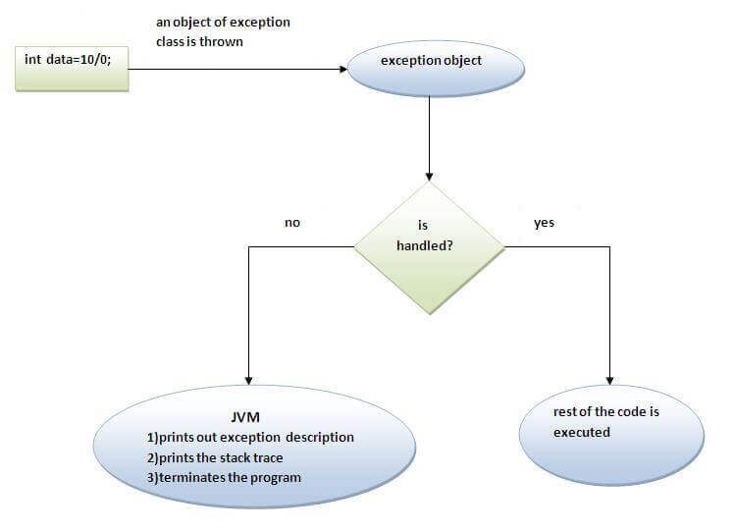
Internal working of java try catch block

Slide 21
Multiple catch clauses
In some cases, more than one exception could be raised by a single piece of code.
To handle this type of situation, you can specify two or more catch clauses, each catching a different type of exception. When an exception is thrown, each catch statement is inspected in order, and the first one whose type matches that of the exception is executed.
After one catch statement executes, the others are bypassed, and execution continues after the try /catch block.
At a time only one exception occurs and at a time only one catch block is executed.
All catch blocks must be ordered from most specific to most general, Example: catch for ArithmeticException must come before catch for Exception.

Slide 22
Example
public class Main {
public static void main(String[] args) {
try{
String x="ABC";
int a[]=new int[5];
a[0]=30/0;//It will raise ArithmeticException
//System.out.println(a[7]);//It will raise ArrayIndexOutOfBoundsException
//System.out.println(Integer.parseInt(x));//It can raise NumberFormatException, but its specific catch is not written so catch with Exception class will work
}
catch(ArithmeticException e)
{
System.out.println("Arithmetic Exception occurs");
}
catch(ArrayIndexOutOfBoundsException e)
{
System.out.println("ArrayIndexOutOfBounds Exception occurs");
}
catch(Exception e)
{
System.out.println("Parent Exception occurs");
}
System.out.println("rest of the code");
}
}

Slide 23
Multi-catch feature introduced from JDK 7 onwards
// Demonstrate the multi-catch feature.
public class Main {
public static void main(String args[]) {
int a=10, b=0;
int vals[] = { 1, 2, 3 };
try {
int result = a / b; // generate an ArithmeticException
//vals[10] = 19; // generate an ArrayIndexOutOfBoundsException
// This catch clause catches both exceptions.
} catch(ArithmeticException | ArrayIndexOutOfBoundsException e) {
System.out.println("Exception caught: " + e);
}
System.out.println("After multi-catch.");
}
}
Output:
Exception caught: java.lang.ArithmeticException: / by zero
After multi-catch.

Slide 24
Example, where compilation error could come
public class Main {
public static void main(String[] args) {
try{
String x="ABC";
int a[]=new int[5];
a[0]=30/0;//It will raise ArithmeticException
//System.out.println(a[7]);//It will raise ArrayIndexOutOfBoundsException
//System.out.println(Integer.parseInt(x));//It can raise NumberFormatException, but its specific catch is not written so catch with Exception class will work
}
catch(Exception e)
{
System.out.println("Parent Exception occurs");
}
catch(ArithmeticException e)
{
System.out.println("Arithmetic Exception occurs");
}
catch(ArrayIndexOutOfBoundsException e)
{
System.out.println("ArrayIndexOutOfBounds Exception occurs");
}
System.out.println("rest of the code");
}
}
Here compilation error will come, as general catch handler with super class is written first and then the subclass catches are written

Slide 25
Nested try statements
The try block within a try block is known as nested try block in java.
Sometimes a situation may arise where a part of a block may cause one error and the entire block itself may cause another error. In such cases, exception handlers have to be nested.
Syntax:
....
try
{
statement 1;
statement 2;
try
{
statement 1;
statement 2;
}
catch(Exception e)
{
}
}
catch(Exception e)
{
}
....

Slide 26
Example
public class Main{
public static void main(String args[]){
try{
int arr[]=new int[5];
try{
System.out.println("going to divide");
int b =39/0;
}catch(ArithmeticException e){System.out.println(e+" inner");}
try{
int a[]=new int[5];
a[5]=4;
}catch(ArrayIndexOutOfBoundsException e){System.out.println(e+" inner");}
System.out.println(arr[6]);
}catch(Exception e){System.out.println(e+" outer");}
System.out.println("After try catch");
}
}
Output:
going to divide
java.lang.ArithmeticException: / by zero inner
java.lang.ArrayIndexOutOfBoundsException: 5 inner
java.lang.ArrayIndexOutOfBoundsException: 6 outer
After try catch

Slide 27
Defining Generalized Exception Handler
A generalized exception handler is one that can handle the exceptions of all types.
If a class has a generalized as well as specific exception handler, then the generalized exception handler must be the last one.

Slide 28
Example
public class Main{
public static void main(String args[]){
try {
String x=null;
//int c = 12/0;//It will raise ArithmeticException
//System.out.println(c);
System.out.println(x.length());//It will raise NullPointerException
}
catch (Throwable e) //Generalized exception handler, which can handle both exceptions[one at one time]
{
System.out.println(e);
}
}
}

Slide 29
Using throw keyword
The throw keyword in Java is used to explicitly throw an exception from a method or any block of code. We can throw either checked or unchecked exception. The throw keyword is mainly used to throw custom exceptions.
Syntax:
throw Instance
Example:
throw new ArithmeticException("/ by zero");
But this exception i.e, Instance must be of type Throwable or a subclass of Throwable.
The flow of execution of the program stops immediately after the throw statement is executed and the nearest enclosing try block is checked to see if it has a catch statement that matches the type of exception.
If it finds a match, controlled is transferred to that statement otherwise next enclosing try block is checked and so on. If no matching catch is found then the default exception handler will halt the program.

Slide 30
public class Main
{
static void demo()
{
try {
throw new NullPointerException("demo");
}
catch(NullPointerException e)
{
System.out.println("Caught inside demo.");
throw e; // rethrow the exception
}
}
public static void main(String args[])
{
try {
demo();
}
catch(NullPointerException e)
{
System.out.println("Recaught: " + e);
}
}
}
Output:
Caught inside demo.
Recaught: java.lang.NullPointerException: demo

Slide 31
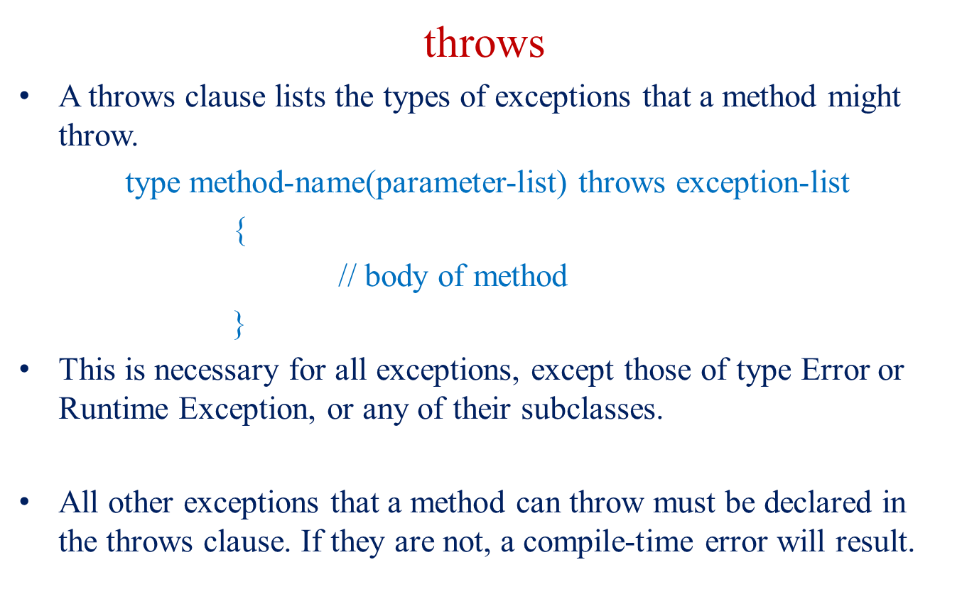
Using throws keyword

Slide 32
Example of throws
import java.io.*;
public class abc {
public static void findFile() throws IOException {
// code that may produce IOException
File newFile=new File("test.txt");
FileInputStream stream=new FileInputStream(newFile);
}
public static void main(String[] args) {
findFile();//try catch block must be used as method throws checked exception
}
}
Output:
C:\Codes>javac abc.java
abc.java:9: error: unreported exception IOException; must be caught or declared to be thrown
findFile();
^
1 error

Slide 33
Enclosing method call inside try-catch which throws the exception
import java.io.*;
public class abc {
public static void findFile() throws IOException {
// code that may produce IOException
File newFile=new File("test.txt");
FileInputStream stream=new FileInputStream(newFile);
}
public static void main(String[] args) {
try{
findFile();
} catch(IOException e){
System.out.println(e);
}
}
}
Output:
java.io.FileNotFoundException: test.txt (No such file or directory)

Slide 34
throw vs throws
No. | throw | throws
1) | Java throw keyword is used to explicitly throw an exception. | Java throws keyword is used to declare an exception.
2) | Throw is followed by an instance. | Throws is followed by class.
3) | Throw is used within the method. | Throws is used with the method signature.
4) | You cannot throw multiple exceptions. | You can declare multiple exceptions e.g. public void method()throws IOException,SQLException.

Slide 35
Finally
finally creates a block of code that will be executed after a try/catch block has completed and before the code following the try/catch block.
The finally block will execute whether or not an exception is thrown.
If an exception is thrown, the finally block will execute even if no catch statement matches the exception.

Slide 36
If a finally block is associated with a try, the finally block will be executed upon conclusion of the try.
The finally clause is optional. However, each try statement requires at least one catch or a finally clause.
Finally block in java can be used to put "cleanup" code such as closing a file, closing connection etc.

Slide 37
Example 1
public class TestFinallyBlock2{
public static void main(String args[]){
try{
int data=25/0;
System.out.println(data);
}
catch(ArithmeticException e){System.out.println(e);}
finally{System.out.println("finally block is always executed");}
System.out.println("rest of the code...");
}
}
Output:Exception in thread main java.lang.ArithmeticException:/ by zero
finally block is always executed
rest of the code...

Slide 38
Example 2
// Demonstrate finally.
public class Main {
// Throw an exception out of the method.
static void procA() {
try {
System.out.println("inside procA");
throw new RuntimeException("demo");
} finally {
System.out.println("procA's finally");
}
}
// Return from within a try block.
static void procB() {
try {
System.out.println("inside procB");
return;
} finally {
System.out.println("procB's finally");
}
}
// Execute a try block normally.
static void procC() {
try {
System.out.println("inside procC");
} finally {
System.out.println("procC's finally");
}
}
public static void main(String args[]) {
try {
procA();
} catch (Exception e) {
System.out.println("Exception caught");
}
procB();
procC();
}
}
Output:
inside procA
procA's finally
Exception caught
inside procB
procB's finally
inside procC
procC's finally

Slide 39
Propagation of Exceptions
If an exception is not caught and handled where it is thrown, the control is passed to the method that has invoked the method where the exception was thrown.
The propagation continues until the exception is caught, or the control passes to the main method, which terminates the program and produces an error message.

Slide 40
Example
public class Main{
public void first(){int data=50/0; }
public void second(){first();}
public void third(){try{second();}
catch(Exception e){ System.out.println("Exception occurred");}
}
public static void main(String [] args){
Main ob = new Main();
ob.third();
System.out.println("Thank You");
}
}
Output:
Exception occurred
Thank You

Slide 41
Built-in Exceptions
Built-in exceptions are the exceptions which are available in Java libraries. These exceptions are suitable to explain certain error situations. Below is the list of important built-in exceptions in Java.

Slide 42
ArithmeticException It is thrown when an exceptional condition has occurred in an arithmetic operation.
ArrayIndexOutOfBoundsException It is thrown to indicate that an array has been accessed with an illegal index. The index is either negative or greater than or equal to the size of the array.
ClassNotFoundException This Exception is raised when we try to access a class whose definition is not found
FileNotFoundException This Exception is raised when a file is not accessible or does not open.
IOException It is thrown when an input-output operation failed or interrupted
InterruptedException It is thrown when a thread is waiting , sleeping , or doing some processing , and it is interrupted.

Slide 43
NoSuchFieldException It is thrown when a class does not contain the field (or variable) specified
NoSuchMethodException It is thrown when accessing a method which is not found.
NullPointerException This exception is raised when referring to the members of a null object. Null represents nothing
NumberFormatException This exception is raised when a method could not convert a string into a numeric format.
RuntimeException This represents any exception which occurs during runtime.
StringIndexOutOfBoundsException It is thrown by String class methods to indicate that an index is either negative or greater than the size of the string

Slide 44
Few Examples ArithmeticException
Output:
Can't divide a number by 0
Code will execute after the exception handled
// Java program to demonstrate ArithmeticException
class Main
{
public static void main(String args[])
{
try {
int a = 30, b = 0;
int c = a/b; // cannot divide by zero
System.out.println ("Result = " + c);
}
catch(ArithmeticException e) {
System.out.println ("Can't divide a number by 0");
}
System.out.println("Code will execute after the exception handled");
}
}
If we use try catch block to handle the exceptions then code will be executed even after the exception is thrown which is not possible without handling the exception. If we do not handle the exception then JVM will give built in exception message and terminate the program.

Slide 45
NullPointerException
//Java program to demonstrate NullPointerException
class NullPointer_Demo
{
public static void main(String args[])
{
try {
String a = null; //null value
System.out.println(a.charAt(0));
} catch(NullPointerException e) {
System.out.println("NullPointerException..");
}
}
}

Slide 46
ArrayIndexOutOfBounds Exception
public class Main {
public static void main(String args[]) {
int a[]=new int[5];
try {
System.out.println(a[7]);
}
catch(ArrayIndexOutOfBoundsException e)
{
System.out.println(e);
}
System.out.println("After try catch...");
}
}
Output:
java.lang.ArrayIndexOutOfBoundsException: 7
After try catch...

Slide 47
StringIndexOutOfBoundsException
public class Main {
public static void main(String args[]) {
String x="Testing";
try {
System.out.println(x.charAt(7));
}
catch(StringIndexOutOfBoundsException e)
{
System.out.println(e);
}
System.out.println("After try catch...");
}
}
Output:
java.lang.StringIndexOutOfBoundsException: String index out of range: 7
After try catch...

Slide 48
User-Defined Exceptions
Sometimes, the built-in exceptions in Java are not able to describe a certain situation. In such cases, user can also create exceptions which are called ‘user-defined Exceptions’. Following steps are followed for the creation of user-defined Exception.
Step 1:
The user should create an exception class as a subclass of Exception class. Since all the exceptions are subclasses of Exception class, the user should also make his class a subclass of it. This is done as:
Class MyException extends Exception

Slide 49
We can write a default constructor in his own exception class. MyException(){}
We can also create a parameterized constructor with a string as a parameter. We can use this to store exception details. We can call super class(Exception) constructor from this and send the string there. MyException(String str) { super(str); }

Slide 50
Step 2:
To raise exception of user-defined type, we need to create an object to his exception class and throw it using throw clause, as: MyException me = new MyException(“Exception details”); throw me;

Slide 51
Example
// Java program to demonstrate user defined exception
class MyException extends Exception
{
private static int accno[] = {1001, 1002, 1003, 1004,1005};
private static String name[] = {"Nish", "Shubh", "Sush", "Abhi", "Akash"};
private static double bal[] = {10000.00, 12000.00, 5600.0, 999.00, 1100.55};
MyException() { }
MyException(String str) { super(str);
}
--------------------------------------------------------------Output:
1001 Nish 10000.0
1002 Shubh 12000.0
1003 Sush 5600.0
1004 Abhi 999.0
Main: Balance is less than 1000
at Main.main(Main.java:18)
Program is running fine after handlng the exception.
public static void main(String[] args)
{
try {
for (int i = 0; i < 5 ; i++)
{ System.out.println(accno[i] + "\t" + name[i] +"\t" + bal[i]);
if (bal[i] < 1000)
{
MyException me = new MyException("Balance is less than 1000");
throw me;
}
}
}
catch (MyException e) {
e.printStackTrace();
}
System.out.println("Program is running fine after handlng the exception.");
}
}

Slide 52
Methods of Throwable class
printStackTrace():
It is a method of Java’s throwable class which prints the throwable along with other details like the line number and class name where the exception occurred.
getMessage():
The getMessage() method of Java Throwable class is used to get a detailed message of the Throwable[or Exception thrown].

Slide 53
Example 1
public class Main
{
public static void main(String[] args) {
try
{
int a=12,b=0;
System.out.println(a/b);
}
catch(ArithmeticException e)
{
System.out.println(e);
e.printStackTrace();
System.out.println(e.getMessage());
}
}
}
Output:
java.lang.ArithmeticException: / by zero
java.lang.ArithmeticException: / by zero
at Main.main(Main.java:8)
/ by zero

Slide 54
Example 2
public class Main
{
public static void main(String[] args) {
try
{
throw new ArithmeticException("Wrong denominator");
}
catch(ArithmeticException e)
{
System.out.println(e);
e.printStackTrace();
System.out.println(e.getMessage());
}
}
}
Output:
java.lang.ArithmeticException: Wrong denominator
java.lang.ArithmeticException: Wrong denominator
at Main.main(Main.java:7)
Wrong denominator

Slide 55
Example 3
public class Main
{
public static void main(String[] args) {
try
{
throw new ArithmeticException();
}
catch(ArithmeticException e)
{
System.out.println(e);
e.printStackTrace();
System.out.println(e.getMessage());
}
}
}
Output:
java.lang.ArithmeticException
java.lang.ArithmeticException
at Main.main(Main.java:7)
null

Slide 56
Q1 Predict the output of following Java program
public class Main {
public static void main(String args[]) {
try {
throw 10;
}
catch(int e) {
System.out.println("Got the Exception " + e);
}
}
}
Got the Exception 10
Got the Exception 0
Compiler Error
Blank output
Notes:
C(In Java only throwable objects (Throwable objects are instances of any subclass of the Throwable class) can be thrown as exception. So basic data type can no be thrown at all)

Slide 57
Q2:What will be the output of following code?
class Test extends Exception { }
public class Main {
public static void main(String args[]) {
try {
throw new Test();
}
catch(Test t) {
System.out.println("Got the Test Exception");
}
finally {
System.out.println("Inside finally block ");
}
}
}
A. Got the Test Exception
Inside finally block
B. Got the Test Exception
C. Inside finally block
D. Compiler Error
Notes:
A

Slide 58
Q3:What will be the output of following Java program?
public class Main {
public static void main(String args[]) {
int x = 0;
int y = 10;
int z = y/x;
}
}
A. Compiler Error
B. Compiles and runs fine
C. Compiles fine but throws ArithmeticException exception
D. None of these
Notes:
C

Slide 59
What will be the output of following code?[Q4]
public class Test
{
public static void main (String[] args)
{
try
{
int a = 0;
System.out.println ("a = " + a);
int b = 20 / a;
System.out.println ("b = " + b);
}
catch(ArithmeticException e)
{
System.out.println ("Divide by zero error");
}
finally
{
System.out.println ("inside the finally block");
}
}
}
A. Compile error
B. Divide by zero error
C. a = 0
Divide by zero error
inside the finally block
D. a = 0
Notes:
C

Slide 60
What will be the output of following code?[Q5]
public class Test
{
public static void main(String[] args)
{
try
{
int a[]= {1, 2, 3, 4};
for (int i = 1; i <= 4; i++)
{
System.out.println ("a[" + i + "]=" + a[i] + "n");
}
}
catch (Exception e)
{
System.out.println ("error = " + e);
}
catch (ArrayIndexOutOfBoundsException e)
{
System.out.println ("ArrayIndexOutOfBoundsException");
}
}
}
A. Compiler error
B. Run time error
C. ArrayIndexOutOfBoundsException
D. Array elements are printed
Notes:
A

Slide 61
Predict the output of the following program.[Q6]
public class Test
{ int count = 0;
void A() throws Exception
{
try
{
count++;
try
{
count++;
try
{
count++;
throw new Exception();
}
catch(Exception ex)
{
count++;
throw new Exception();
}
}
catch(Exception ex)
{
count++;
}
}
catch(Exception ex)
{
count++;
}
}
void display()
{
System.out.println(count);
}
public static void main(String[] args) throws Exception
{
Test obj = new Test();
obj.A();
obj.display();
}
}
4
5
6
Compilation error
Notes:
B

Slide 62
Which of these is a super class of all errors and exceptions in the Java language?[Q7]
A. RunTimeExceptions
B. Throwable
C. Catchable
D. None of the above
Notes:
B

Slide 63
Output??[Q8]
public class Test
{
public static void main(String[] args)
{
try
{
System.out.printf("1");
int sum = 9 / 0;
System.out.printf("2");
}
catch(ArithmeticException e)
{
System.out.printf("3");
}
catch(Exception e)
{
System.out.printf("4");
}
finally
{
System.out.printf("5");
}
}
}
a) 1325 b) 1345 c) 1342 d) 135
Notes:
d

Slide 64
Output??[Q9]
public class Test
{
public static void main(String[] args)
{
try
{
System.out.printf("1");
int data = 5 / 0;
}
catch(ArithmeticException e)
{
System.out.printf("2");
System.exit(0);
}
finally
{
System.out.printf("3");
}
System.out.printf("4");
}
}
a) 12 b) 1234 c) 124 d) 123
Notes:
a

Slide 65
Output??[Q10]
public class Test
{
public static void main(String[] args)
{
try
{
System.out.printf("1");
int data = 5 / 0;
}
catch(ArithmeticException e)
{
Throwable obj = new Throwable("Sample");
try
{
throw obj;
}
catch (Throwable e1)
{
System.out.printf("8");
}
}
finally
{
System.out.printf("3");
}
System.out.printf("4");
}
}
a) Compilation error b) Runtime error c) 1834 d) 134
Notes:
C

Slide 66
Output??[Q11]
import java.io.EOFException;
import java.io.IOException;
public class Test
{
public static void main(String[] args)
{
try
{
System.out.printf("1");
int value = 10 / 0;
throw new IOException();
}
catch(EOFException e)
{
System.out.printf("2");
}
catch(ArithmeticException e)
{
System.out.printf("3");
}
catch(NullPointerException e)
{
System.out.printf("4");
}
catch(IOException e)
{
System.out.printf("5");
}
catch(Exception e)
{
System.out.printf("6");
}
}
}
a) 1346 b) 136726 c) 136 d) 13
Notes:
d

Slide 67
Output??[Q12]
public class Main
{
public static void main(String[] args) {
try
{
System.out.print("Hello" + " " + 1 / 0);
}
catch(ArithmeticException e)
{
System.out.print("World");
}
}
}
a) Hello b) World c) HelloWorld d) Hello World
Notes:
b

Slide 68
Output??[Q13]
What will be the output of the following Java program?
public class exception_handling
{
public static void main(String args[])
{
try
{
int a, b;
b = 0;
a = 5 / b;
System.out.print("A");
}
catch(ArithmeticException e)
{
System.out.print("B");
}
}
}
a) A
b) B
c) Compilation Error
d) Runtime Error
Notes:
B

Slide 69
Output??[Q14]
// Demonstrate the multi-catch feature.
public class Main {
public static void main(String args[]) {
int sum=10;
try
{
int i;
for (i = -1; i < 3 ;++i)
sum = (sum / i);
}
catch(ArithmeticException e)
{
System.out.print("0 ");
}
System.out.print(sum);
}
}
0 -10
0 10
Compile time error
0
Notes:
A

